Slide 1

Online Learning Platform Analysis (Using SQL)

Slide 2

INTRODUCTION
In today’s fast-paced digital era, online learning platforms like Udemy, Coursera, and LinkedIn Learning are transforming how people acquire new skills. With thousands of courses and learners worldwide, understanding student behavior, course effectiveness, and revenue patterns is crucial for driving growth and engagement.

Slide 3
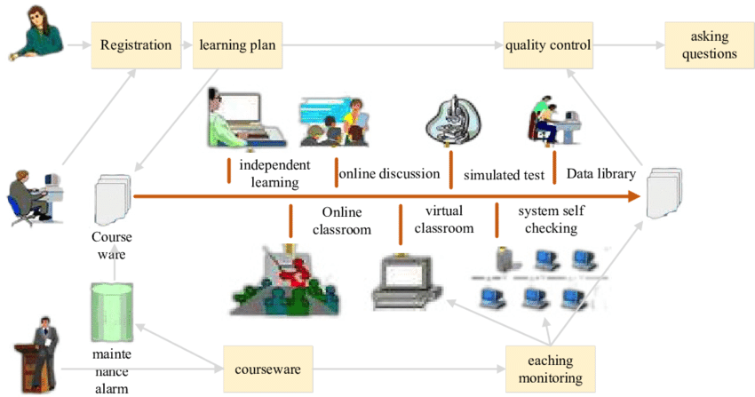

Slide 4
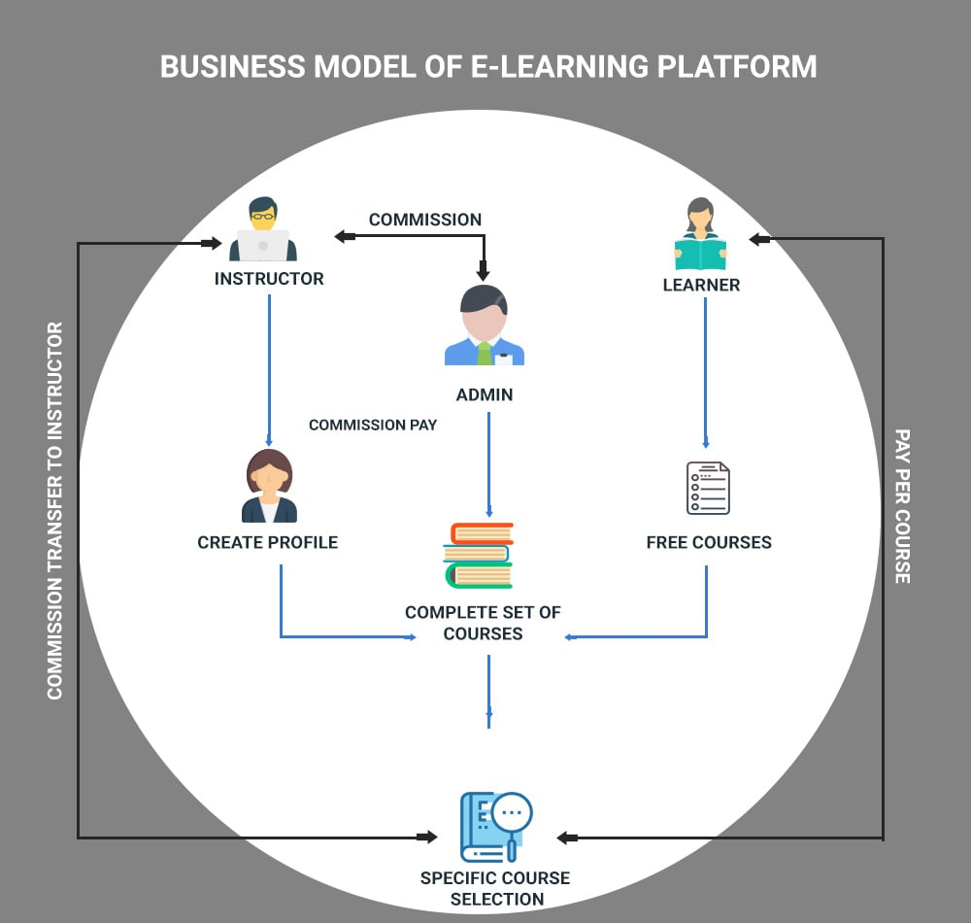

Slide 5

The company aims to:
Analyze learner activity, dropout trends, and course completion behavior.
Track top-performing and underperforming courses.
Evaluate instructor impact based on course ratings and earnings.
Understand revenue flow by course, instructor, and category.
Detect usage trends across professions, cities, and time periods.
Identify reasons behind low engagement, poor reviews, or refunds.
Build summarized dashboards and reusable views using SQL queries.

Slide 6
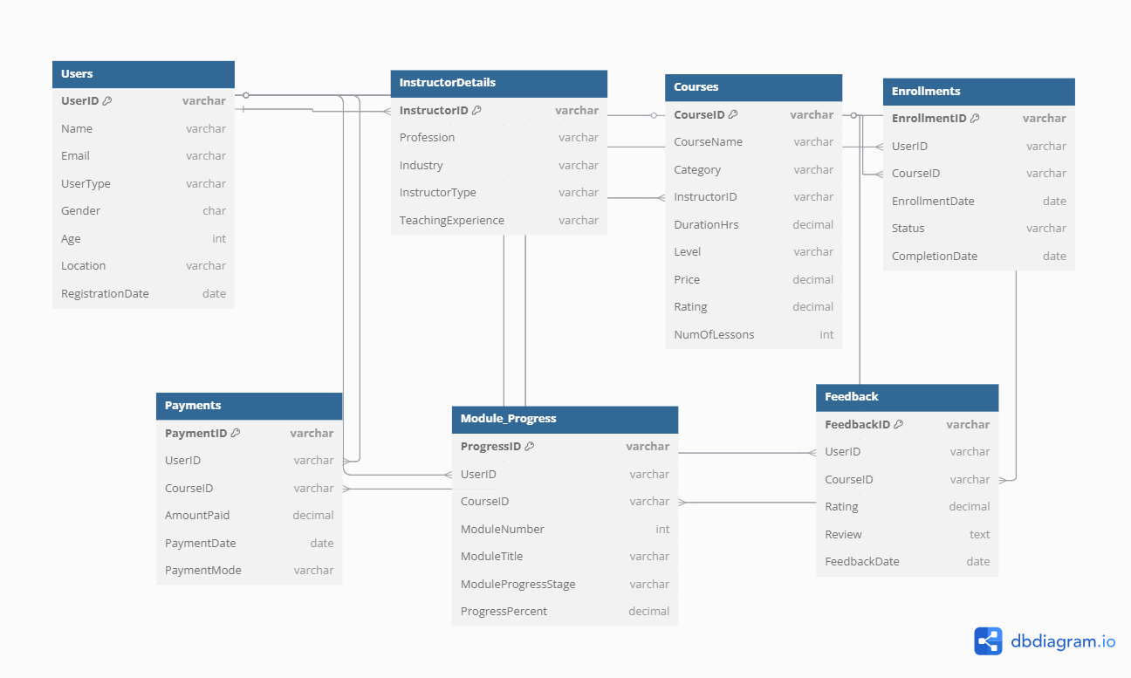
Entity Relationship Diagram of Online Learning Platform

Slide 7
Relationship Description | Type
Users 1️ — ∞ Enrollments | One user can enroll in many courses
Courses 1 — ∞ Enrollments | One course can have many students
Courses 1️— ∞ Payments | Payments per course tracked
Courses 1️— ∞ Module_Progress | Course progress broken down by modules
Courses 1 — ∞ Feedback | One course, many reviews
Courses ∞ — 1 Instructors (via Users + InstructorDetails) | Many courses are taught by one instructor
Users 1️— ∞ Payments / Feedback / Module_Progress | One user can have many records

Slide 8
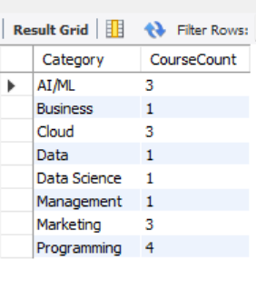

1. List all distinct course categories and their course count sorted alphabetically.

Slide 9
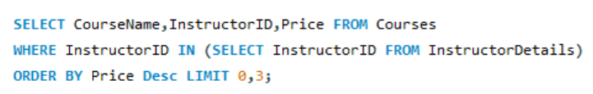

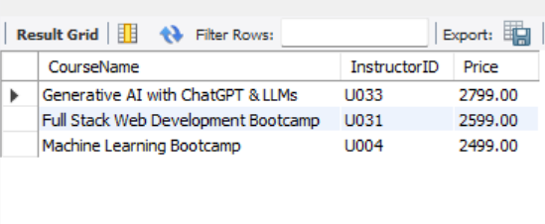
2.Top 3 Most Expensive Courses with Instructors.

Slide 10
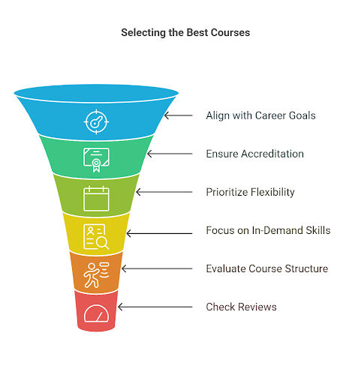
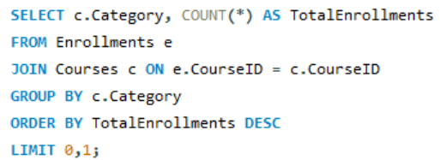
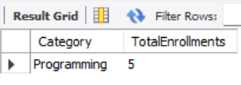
3. Find the most popular course category based on enrollments.

Slide 11

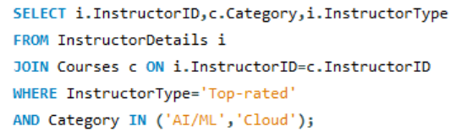
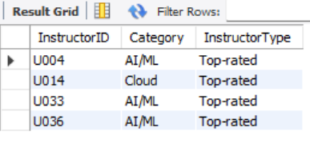
4.List instructors who are 'Top-rated' and teach 'AI/ML’
or 'Cloud'.

Slide 12

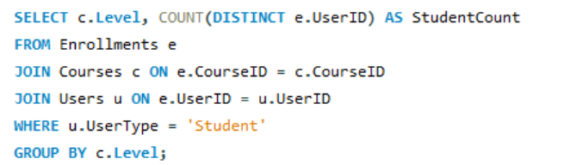
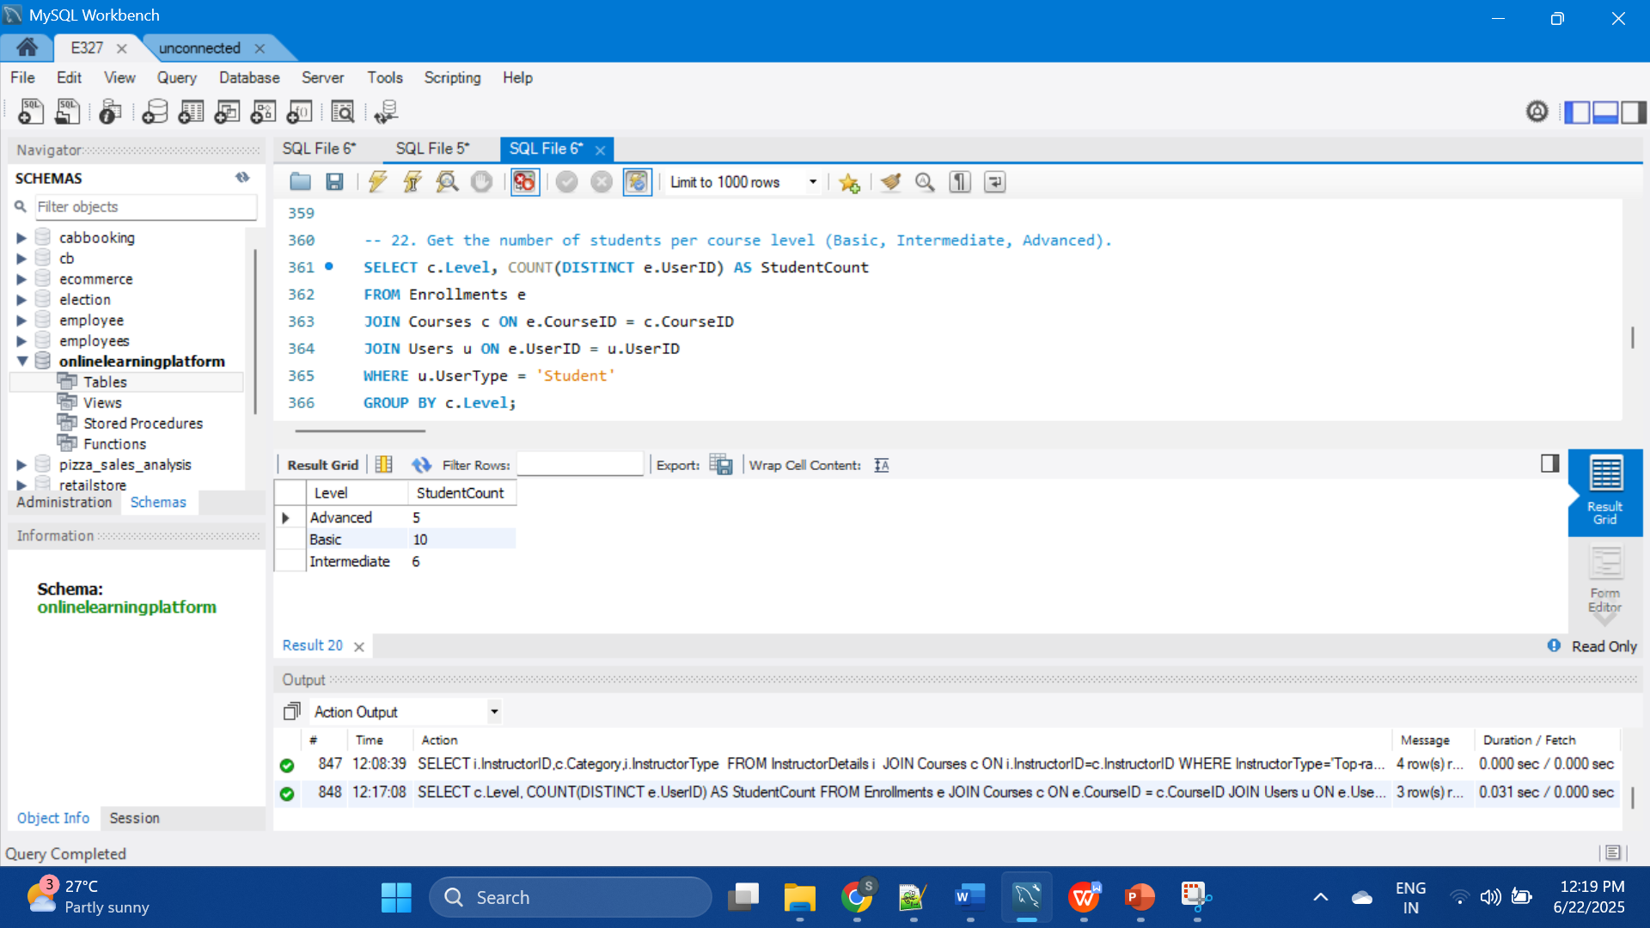
5. The number of students per course level (Basic, Intermediate, Advanced).

Slide 13

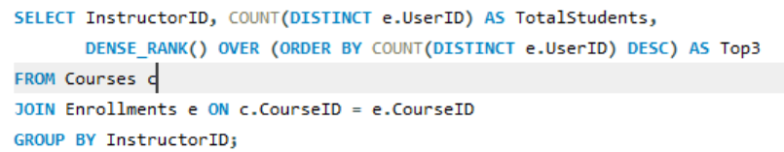
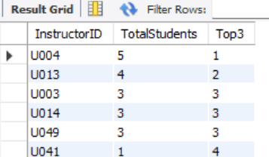
6.Identify top 3 instructors using DENSE_RANK() based on total course enrollments.

Slide 14
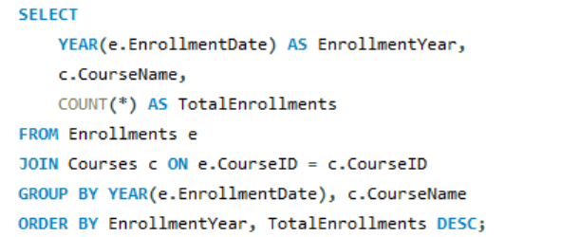

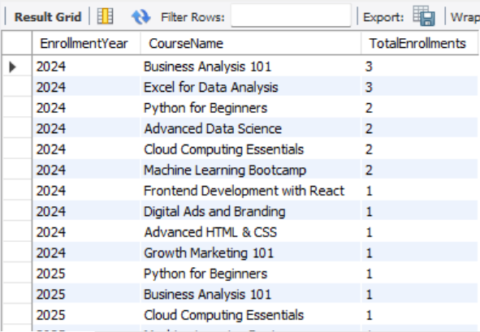
7.Which course(s) have the highest number of enrollments, grouped by year.

Slide 15

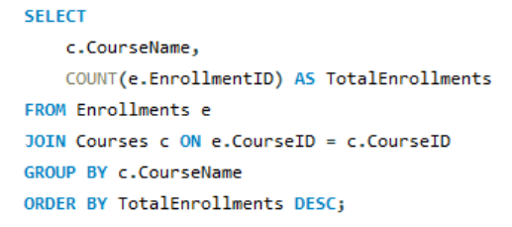
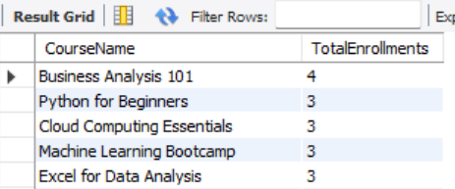
8. List most frequently enrolled courses.

Slide 16

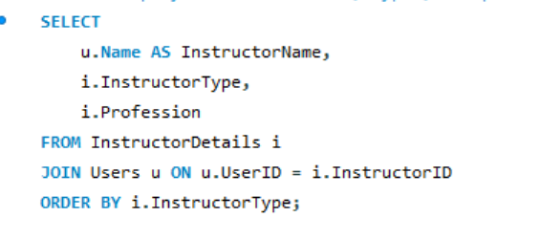
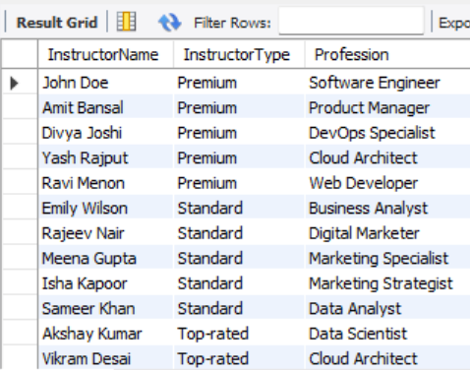
9. Display instructor names, types, and profession, sorted by instructor type.

Slide 17
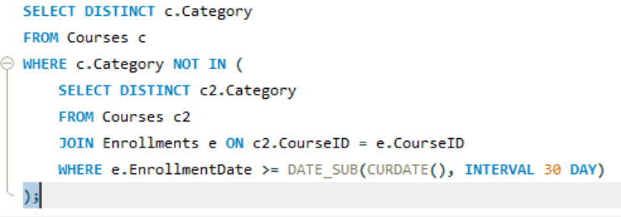
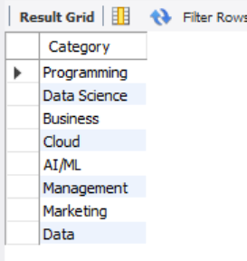

10.List course categories with no enrollments in last 30 days

Slide 18

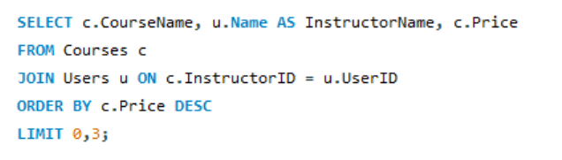
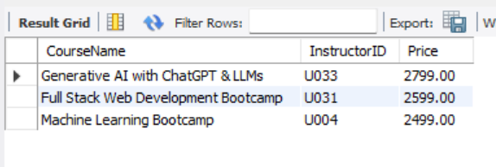
11.Show top 3 most expensive courses along with their instructor

Slide 19

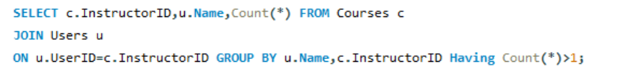
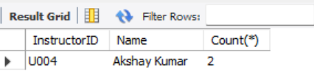
12. Find instructors who teach more than one course.

Slide 20
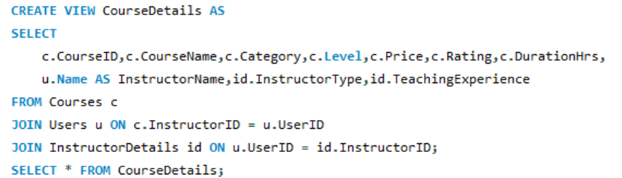
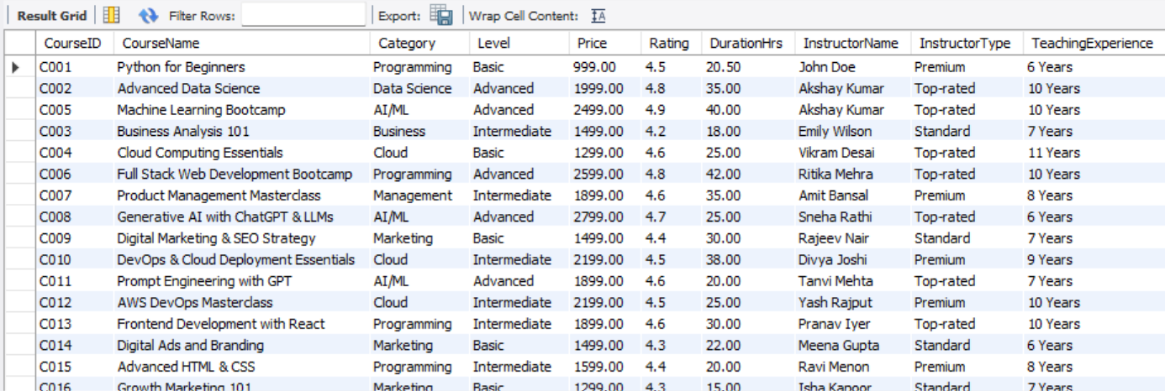
13. Create a view for detailed course info joining Course, Instructor, and Category.

Slide 21

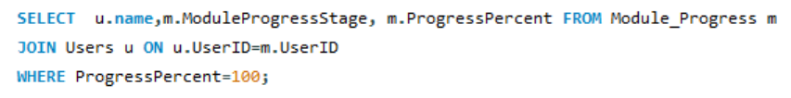
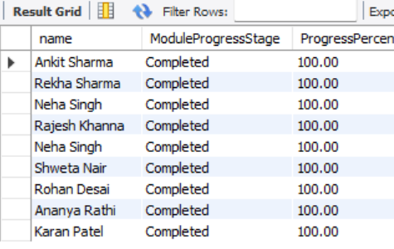
14. Find students who completed all modules (Progress = 100%).

Slide 22

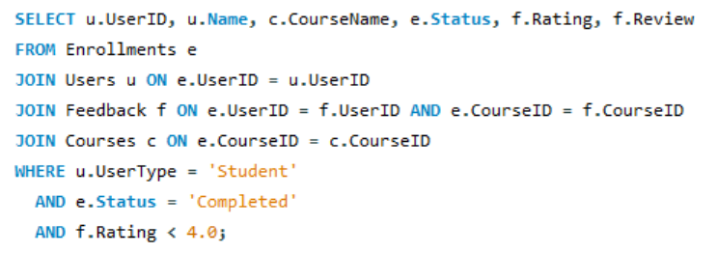
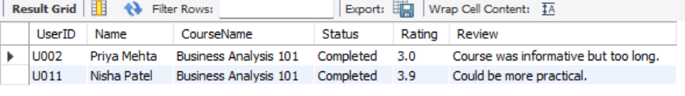
15. Display students who completed courses but gave feedback < 4.0.

Slide 23

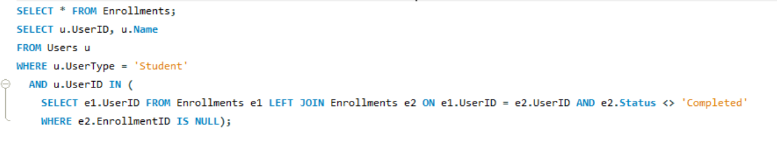
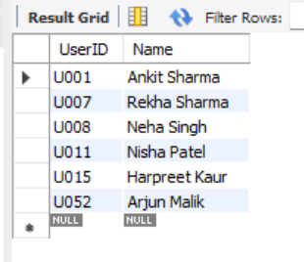
16. Get student names who have completed all enrolled courses

Slide 24

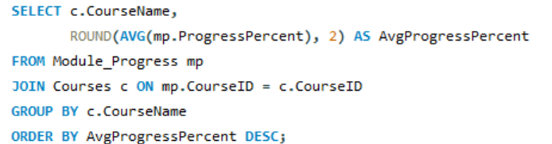
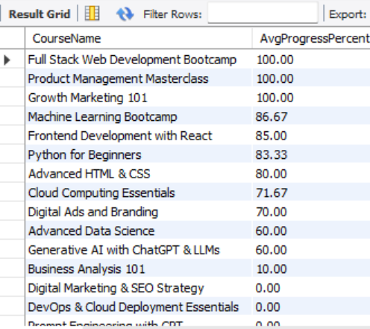
17. Show average progress percent per course across all users.

Slide 25
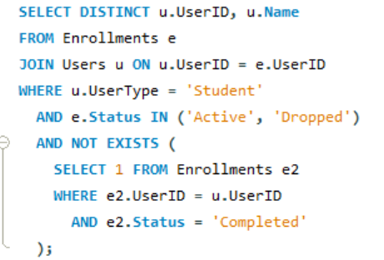

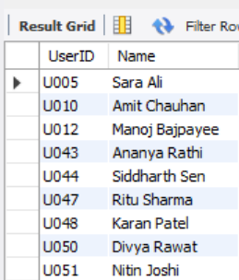
18. List users who started but did not complete any course.

Slide 26

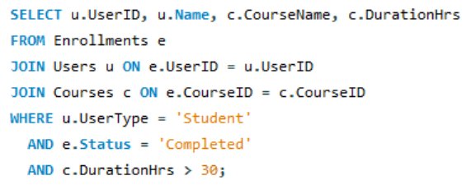
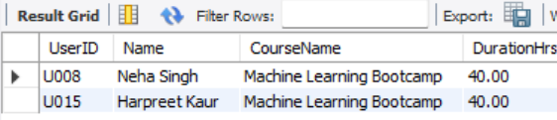
19. List students who completed courses with duration > 30 hrs.

Slide 27

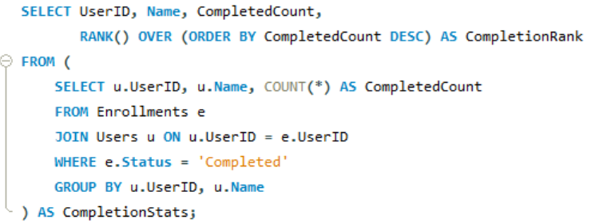
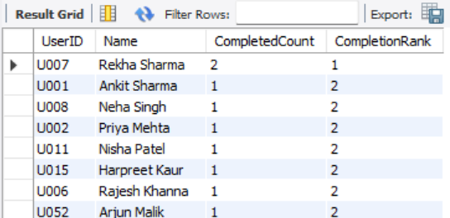
Rank users by number of course completions.
(Using Window Functions)

Slide 28
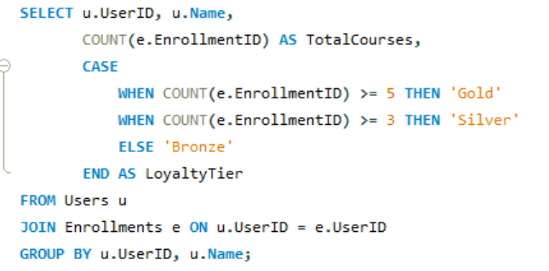


21. Build a Course Loyalty Tier View: (CASE WHEN CompletedCourses > 5 THEN 'Gold' WHEN >3 THEN 'Silver' ELSE 'Bronze'.)

Slide 29

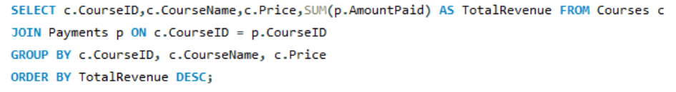
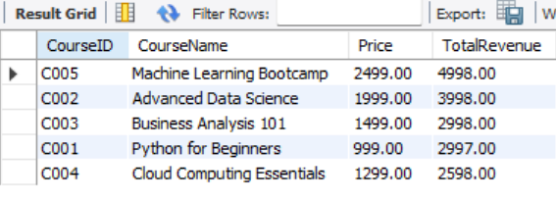
22. Total Revenue by Course

Slide 30

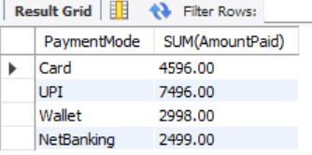
23. Show total revenue collected per payment mode.

Slide 31

Key Insights : Online Learning Platform
3. Revenue & Course Demand
High Revenue Courses
High ROI Categories
Course Completion v/s Revenue
Most Popular Levels
4. Operational Metrics
Average Completion Time by Course
5. Feedback Pattern Analysis
Short vs Long Courses
Comparative & Predictive Insights
6. Payment Mode Preferences
Loyalty Tiers
Instructor-Student Matching
1.Student Behavior & Engagement
Top Students
Dropout Rates
Peak Enrollment Days
2. Instructor Performance & Efficiency
Low-Rated Instructors
Top Instructors by Course Load
Instructor Dropout Correlation

Slide 32

Conclusion:
The Online Learning Platform analysis reveals powerful insights that directly support strategic decision-making for both business and educational goals:
Data-Driven Growth:
The project uncovered trends in course popularity, instructor performance, and learner behavior — enabling smarter content creation and marketing strategies.
User-Centric Improvements:
High dropout rates, unpaid enrollments, and low-rated feedback highlighted areas where user experience and engagement can be enhanced.
Revenue Optimization:
Identifying top-performing courses, instructors, and payment patterns provides clear direction to maximize revenue and ROI.
Advanced Analytics Application:
By implementing 35+ SQL queries, window functions, views, and case-based logic, the platform simulates real-world business intelligence and operational dashboards.
Scalable & Actionable Insights:
These insights form the foundation for developing automated reports, dashboards, and retention strategies for long-term success.

